Slide 1
E-Office Management Suite Project
Stan Ostrovskii

Slide 2
Purpose
This project was to design an application that would assist in the everyday tasks common to many businesses, such as:
Maintaining employee and department information.
Managing employee tasks.
Managing employee time off (sick leave, vacation leave, etc)
Managing room/office availability.

Slide 3
Technologies Used
The project consists of two major sub-components:
A Spring Boot back-end, running on a Tomcat server.
An Angular frontend application, running on a Node.js server
The two applications communicate with each other via a RESTful API

Slide 4
Backend
The backend is written in Java 8 as a Spring Boot project
The Oracle DBMS is used for persistence.
Spring Data JPA (which uses Spring-Hibernate) is used to map Java objects to database tables, using Spring CrudRepository
Spring REST controllers allow other applications, such as the Angular frontend, to access the data.
A service layer serves as an intermediary between the controller and repositories, and performs business logic, such as fetching the data from the respositories, performing security functionalities, and sending e-mails upon certain user requests.

Slide 5
Frontend
The frontend is an Angular application, written in Typescript programming language programming language (a superset of Javascript designed for easier programming)
The views are written in HTML5 with heavy use of Twitter Bootstrap for optimizing the look and feel and adding responsiveness. In fact, I used Bootstrap to make the UI friendly even for most mobile phones.
The application consists of many Angular components, as well as services for fetching data, displaying alerts, and maintaining security.

Slide 6
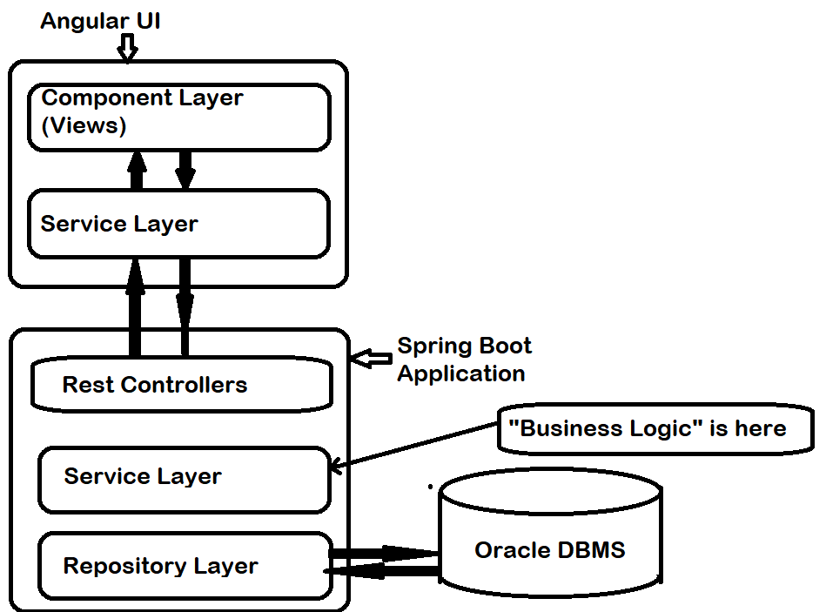
Workflow Diagram

Slide 7
Development and Testing
In the early stages of the backend development, I used JUnit tests integrated with Spring Boot to test my repositories and services.
I extensively used Swagger UI to help test and debug my RESTful endpoints, (as well as the Postman API development environment).

Slide 8
Users and Security
The application allows two distinct user types: an administrator account and an employee (standard user account).
Both use the same login page but get directed to their respective pages upon login.
JWT token-based authentication was used for this project.
Upon log in, the API user is provided a token that they must send with every request requiring authorization.
The user will be required to log in again only if they logout or when the token expires (every 12 hours in my implementation)

Slide 9
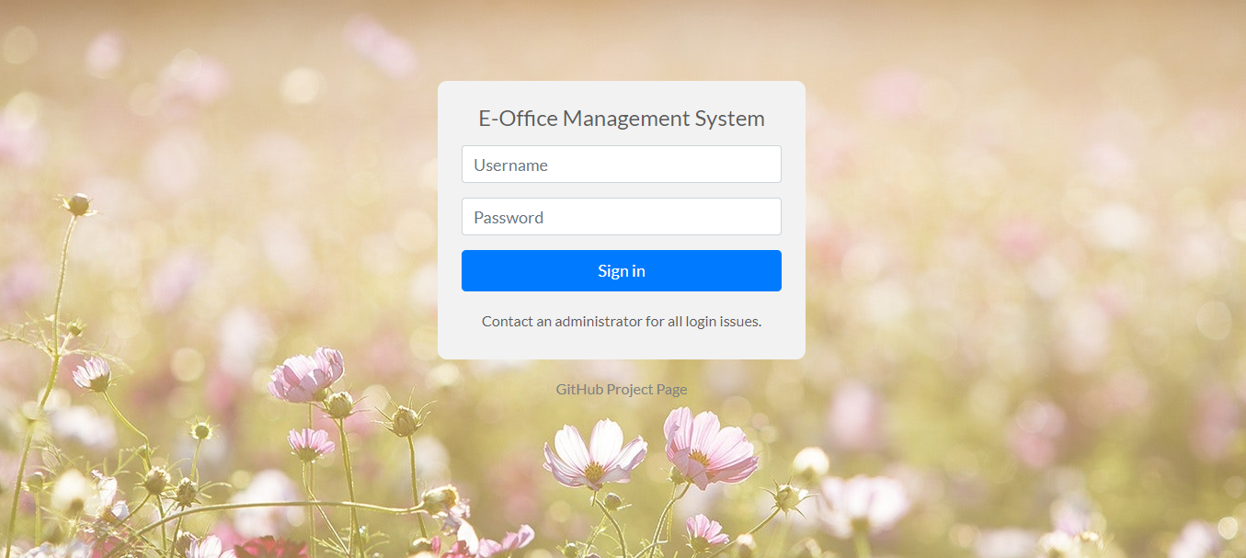
Login Page

Slide 10
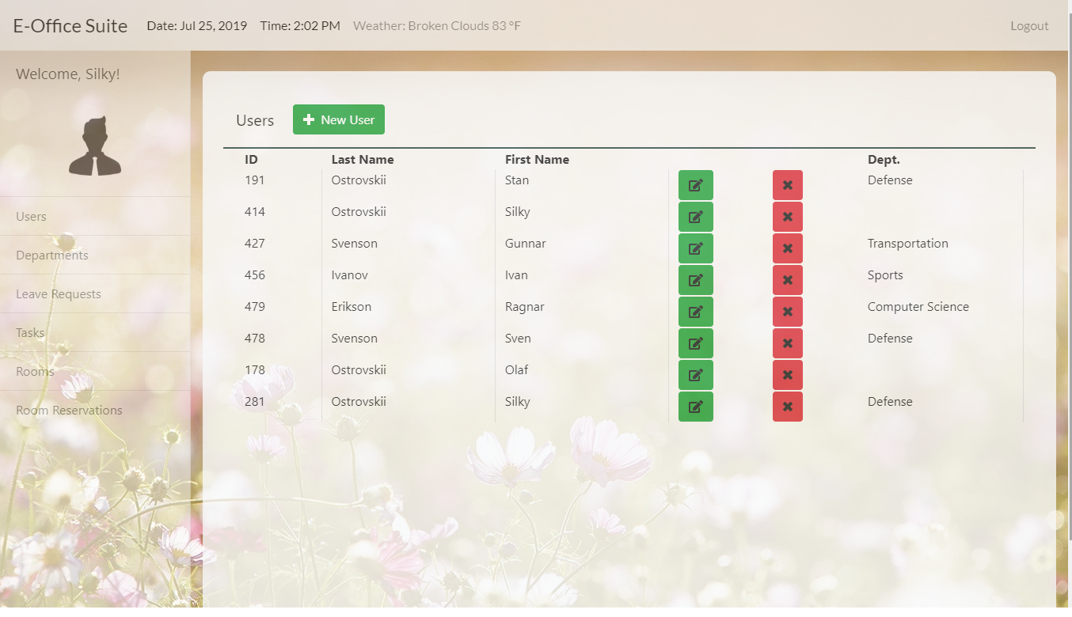
Admin homepage

Slide 11
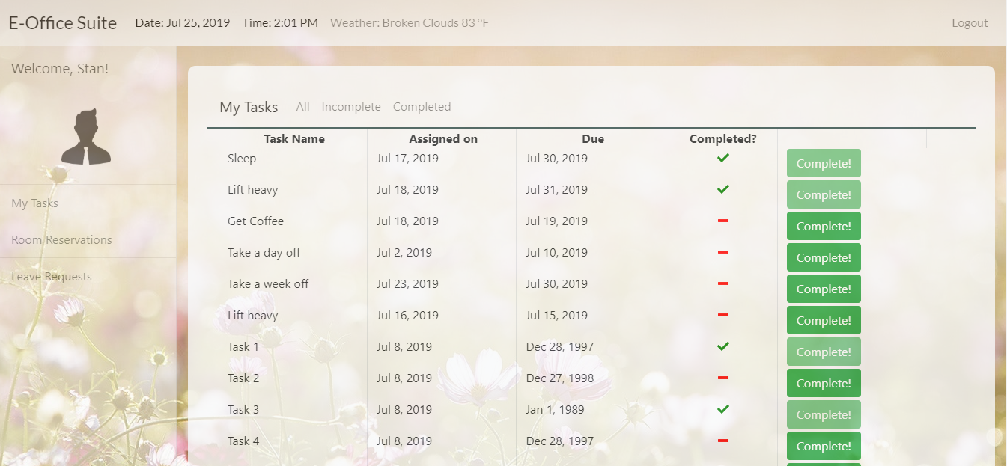
Employee Homepage

Slide 12
Functionality
Once logged in, users will be presented with a variety of tasks and functionalities, depending on their role (employee or admin).
The UI was designed to be as natural, responsive, and robust as possible (presenting the user with appropriate error messages, notifications, and confirmation dialogs as appropriate).

Slide 13
Admin. Functionality
An admin user can:
Create a new employee account.
Create a new department.
Add a new meeting or training room to the database.
Edit or delete existing employees, rooms, and departments.
Assign and notify employees of new tasks.
Approve or reject employee room reservation requests.
Approve or reject employee leave requests.
View their IP address and weather at their current location

Slide 14
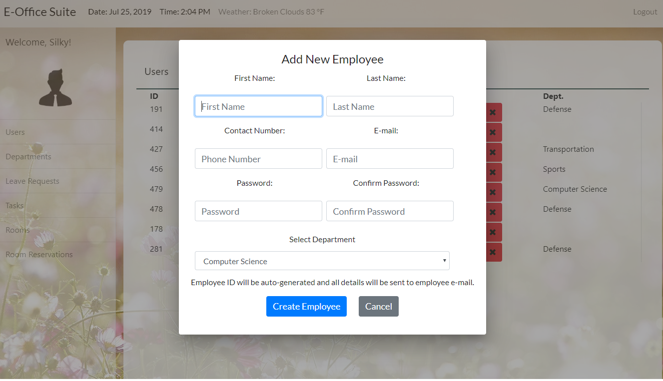
Admin: Add new employee

Slide 15
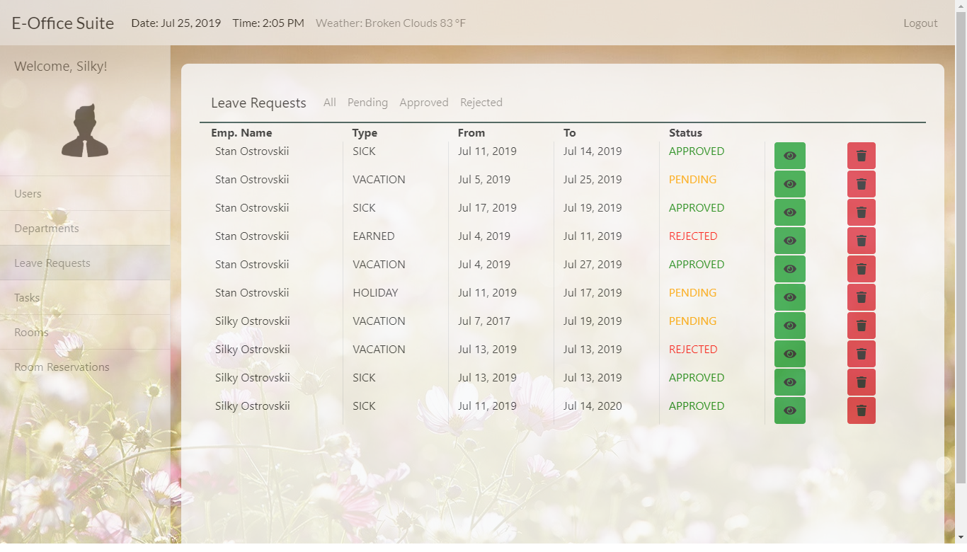
Admin: View leave requests. By clicking on them, the admin can see them in more detail and approve/reject them.

Slide 16
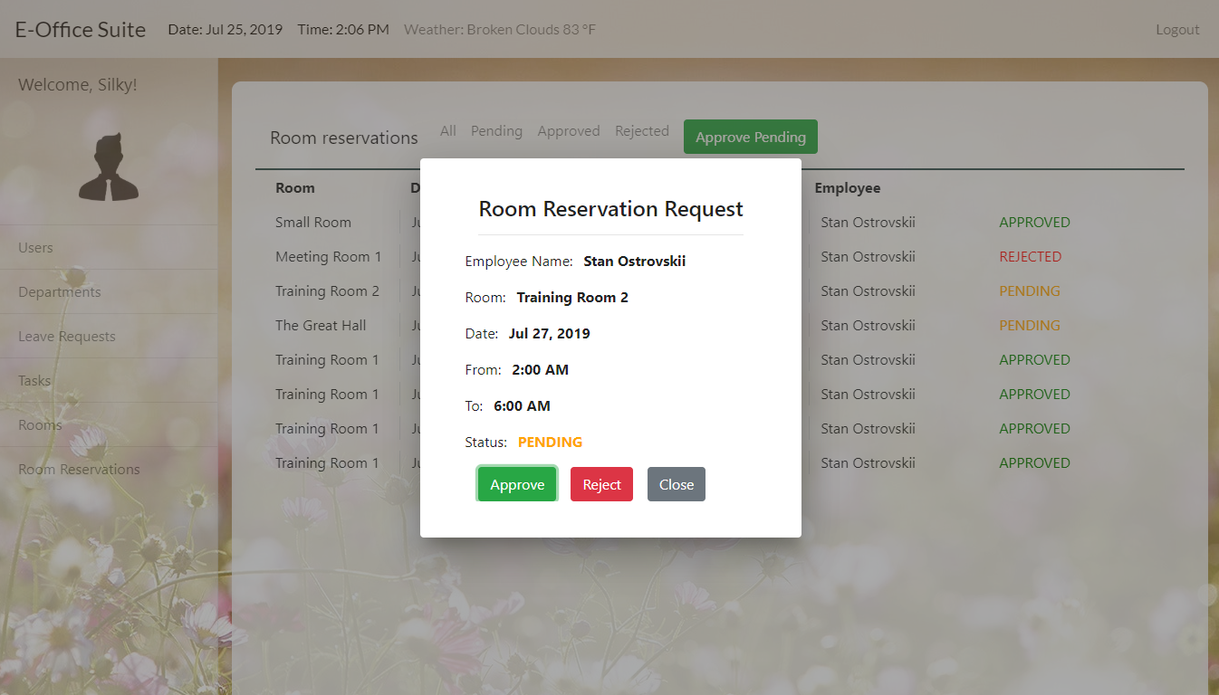
Admin: view and approve/reject reservation requests. Reservations can only be deleted once rejected or expired.

Slide 17
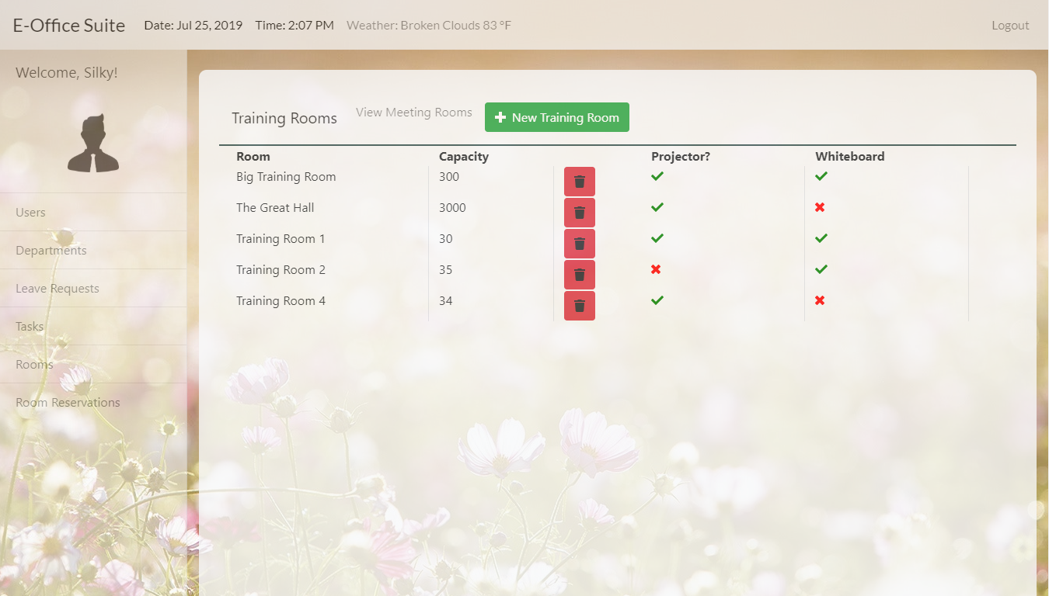
Admin: View and add training and meeting rooms.

Slide 18
Employee Functionality
An employee can:
View assigned tasks and mark them completed.
Request a leave
View the database of available meeting and training rooms.
Request to reserve a meeting or training room
View their IP address and weather at their current location

Slide 19
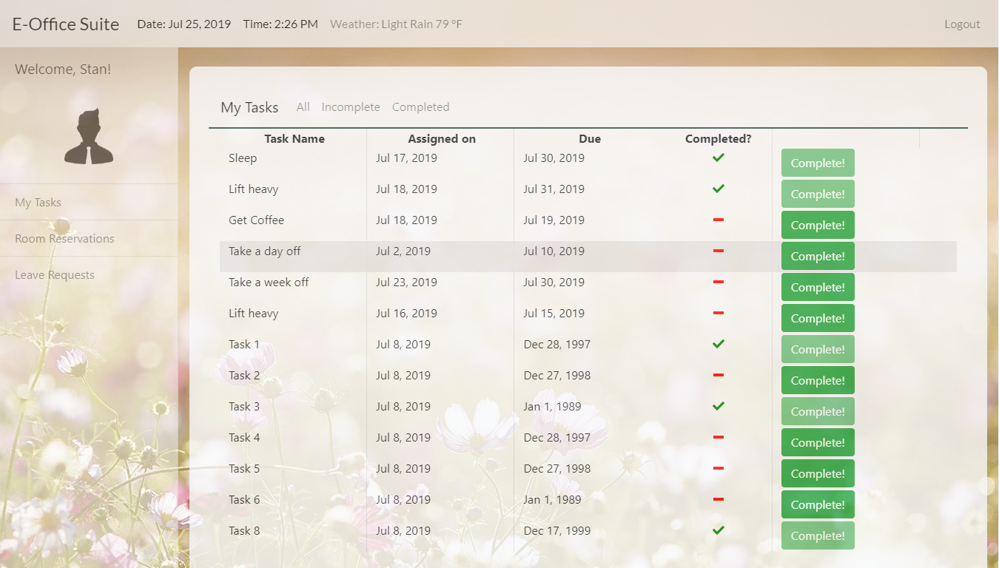
Employee: view and complete tasks.

Slide 20
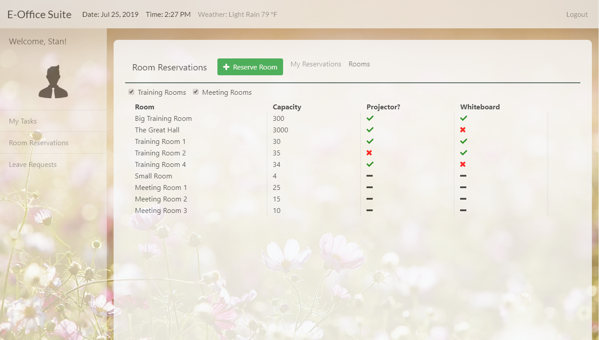
Employee: view rooms. Filter by training or meeting room.

Slide 21
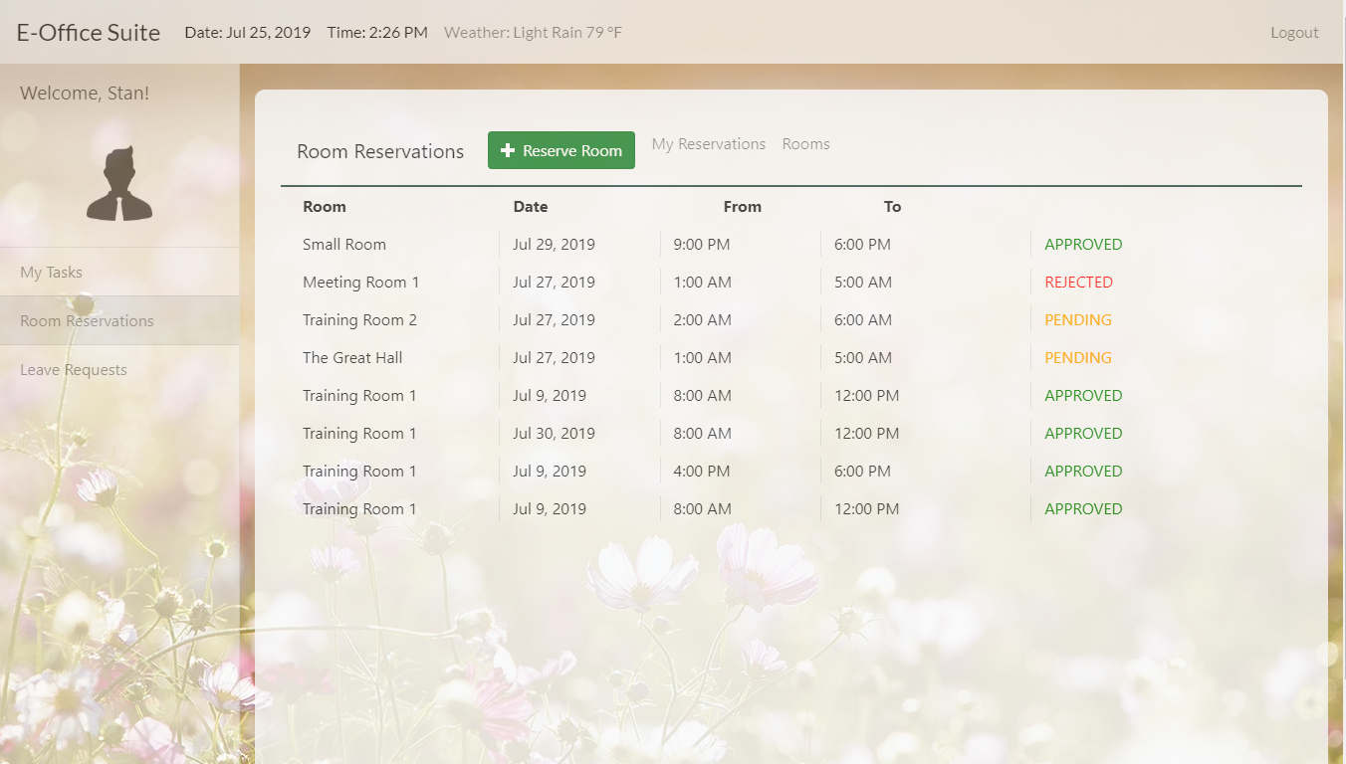
Employee: create room reservation request and view all their requests.

Slide 22
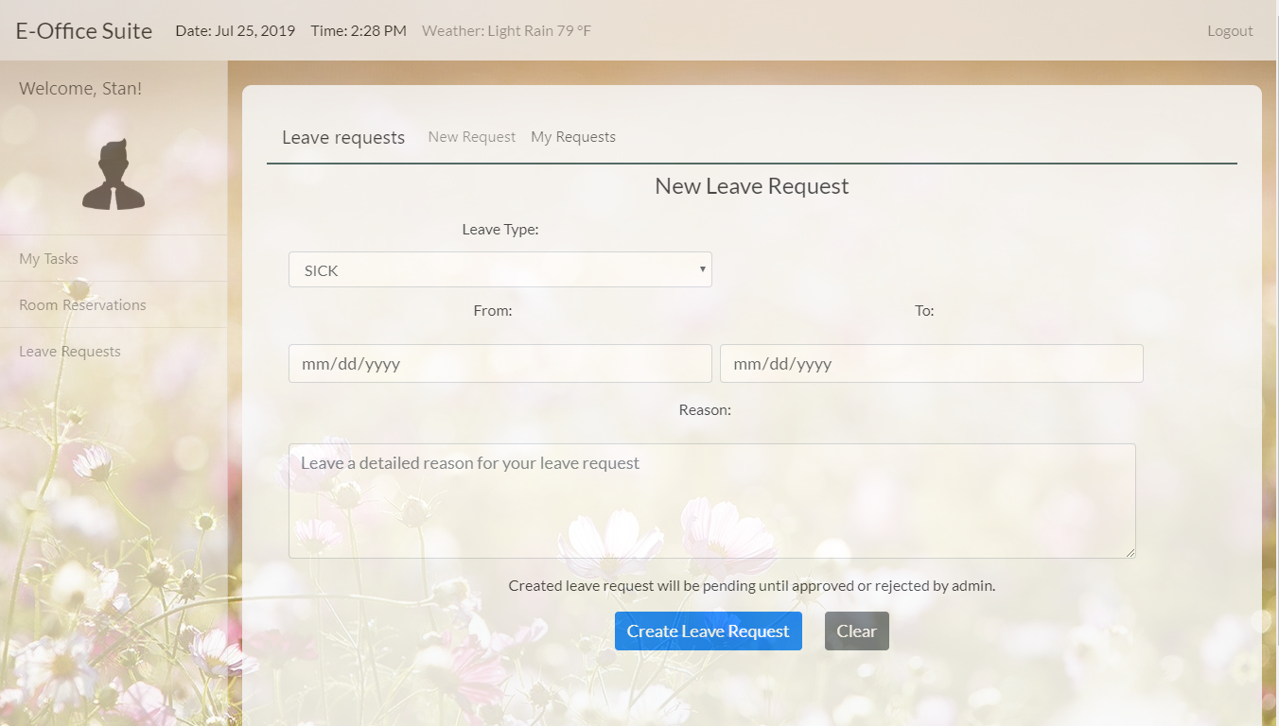
Employee: can file a leave request and view all their requests.

